Slide 1
FIFA WORLD CUP WINNER 2022
Data Analysis CSCI322

Slide 2
Info Of Our Team
Mohamed Yaser Aboshama 202001242
Ahmed Mohamed Sarg 202000818
Ahmed Magdy Eltohamy 202000947
Yousef Mohamed Farouk 202000828

Slide 3
Problem Definition
Trying to predict what team is most likely to win the 2022 FIFA World Cup?
What team has the strongest defense, midfield, and offense players?
Is there really such a thing as a home team advantage?
Do teams with stronger offense players score more goals? And do teams with stronger goalkeepers receive fewer goals?
Does the best team always win?

Slide 4
Used Dataset
This dataset provides a complete overview of all international soccer matches played since the 90s. On top of that, the strength of each team is provided by incorporating actual FIFA rankings as well as player strengths based on the EA Sport FIFA video game.

Slide 5
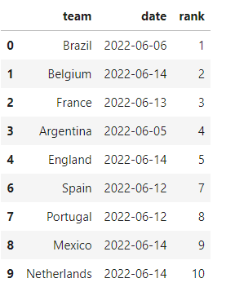
Preparations & Pre-processing
Data cleaning:
Filling null values and missing data with mean.
Dropped unnecessary features.
Dropped unqualified teams from Qatar World Cup 2022

Slide 6
Methods
Logistic Regression:
Used Logistic regression to predict the world club winner
Logistic regression is a statistical model belonging to linear regression models that enables the modeling of a binomial variable in terms of a set of predicted random variables, whether numeric or categorical. Logistic regression is used to predict the probability of an event given the additional values of variables that can be explained or related to that event.

Slide 7
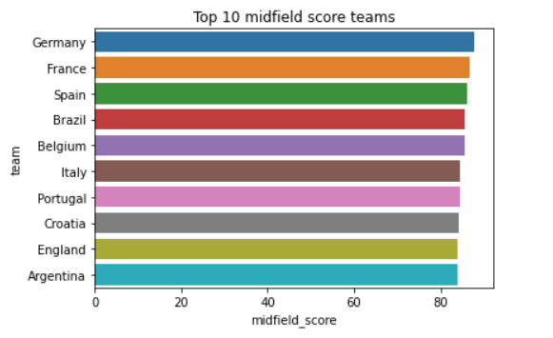
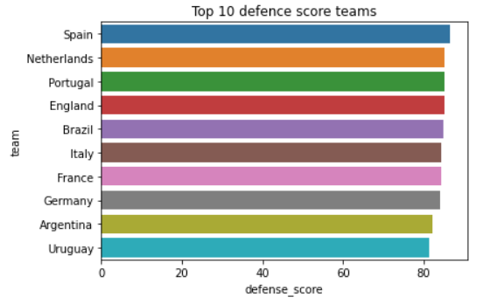
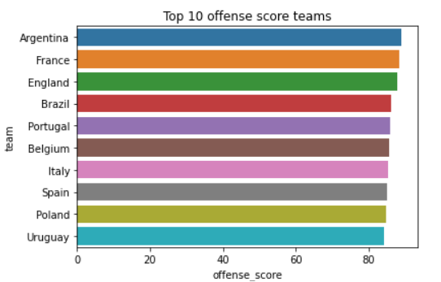
Results
What team has the strongest defense, midfield, and offense players?

Slide 8
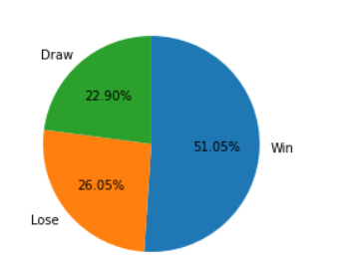
Results
Is there really such a thing as a home team advantage?

Slide 9
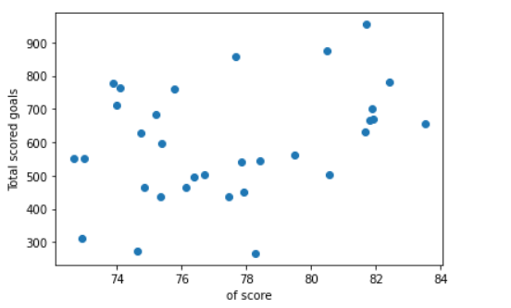
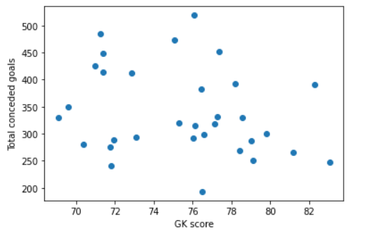
Results
Do teams with stronger offense players score more goals? And do teams with stronger goalkeepers receive fewer goals?

Slide 10
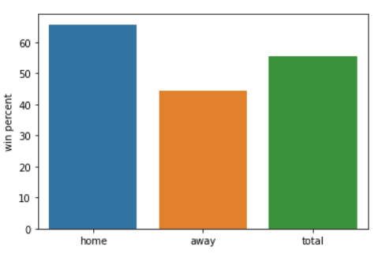
Results
Does the best team always win?

Slide 11
Conclusion
Home team has advantage
There is correlation between strong offense players and the amount of the goals scored
There is a negative correlation between the goalkeeper and the goal’s conceded

